Slide 1
IETF117 – ROSA side meeting
https://datatracker.ietf.org/doc/draft-mendes-rtgwg-rosa-use-cases/
https://datatracker.ietf.org/doc/draft-contreras-rtgwg-rosa-gaar/
Problem statement for ROSA
…and how current solutions fall short
Dirk Trossen (Huawei), Luis Contreras (Telefonica), J. Finkhaeuser (Interpeer), P. Mendes (Airbus)
24.07.2023

Slide 2
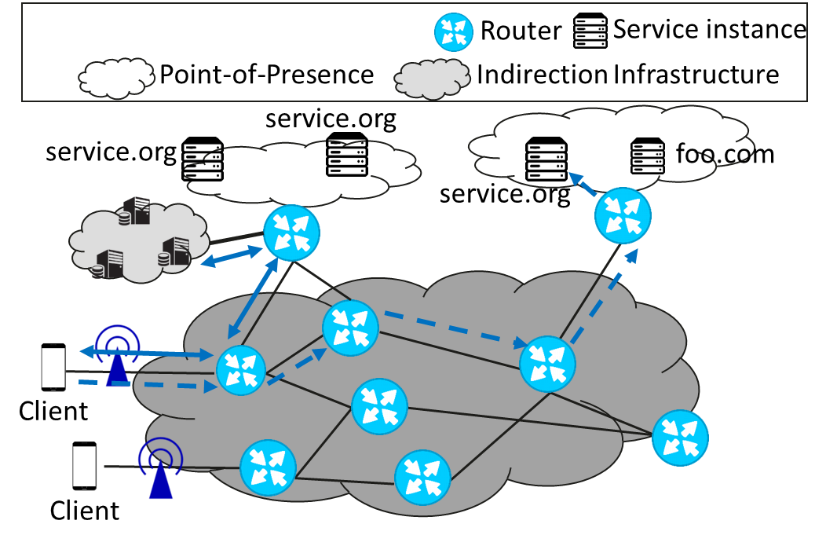
Service Routing as Done Today
Explicitly resolving service name onto network locator
Done through explicit indirection infrastructure
Client issues resolution request first
Client then utilizes resolved network locator for the actual application-level request
Example Technologies
DNS
Global Server Load Balancing (GSLB) for CDN-based load balancing
ALTO (application layer traffic optimizations)
HTTP redirect
LISP (to some extent)
Resolution request
Data request

Slide 3
Issues observed across our use cases
Centered around distribution (of service instances), dynamicity of choice and availability, as well as efficiency to utilize chosen service instance; more specifically
Anycast: more than one service instance available
Dynamic decisions: may want to change choice of service instance frequently, down to single requests even
Ephemeral service instances: may deploy (or ramp down) service instance frequently, e.g., using microservice architectures
Latency: explicit resolution costs time, possibly exceeding delay budget of application or making frequent changes expensive
Service-specific selection: choice of anycast may be based on service-specific policies, in addition to network criteria
Distributed deployment: service instances may exist in different/many network locations, not even in PoPs
Namespace mapping: not all services use URLs
Service chaining: a (composite) service experience may consists of many chained services, accumulating issues on, e.g., latency

Slide 4
WHAT IF…
…a similar end-to-end procedure of data communication between a client and a 'best' choice of service instances (out of set of possibly many) existed that significantly reduced the aforementioned latency, while it allowed for updating the assignments at rates that are more aligned with the possibility to establish new service instances in distributed locations?

Slide 5
Problems to address include
How can we make decisions on anycast-based service instance assignments at high rate, even down to every service request?
How to possibly remove the need for an explicit out-of-band discovery step, which incurs additional latencies before any data transfer can commence?
How could we improve on the update speed for the assignments between service name and 'best' IP locator for the service instance to be used…to align the rate of the possible anycast assignment update with that of the possible availability of the service instance resource?
How could we allow for incorporating service-specific policies into the anycast selection?
How can we support any application identifier space (within the governance defined for that identifier space) beyond domain names?
How could the chaining of more than one service be realized without explicit discovery latency incurred?
How can we possibly preserve such client-driven operation, and thus avoid transaction state in the network?

Slide 6
How Current Solutions Fall Short
DNS: anycast decision in DNS system, using the result to communicate
Explicit resolution before communication takes place with 10s of millisecond or more extra latency
Acting on stale information, if utilizing client cache
Low dynamics for resolution change due to latency in propagating updating resolution mapping
Limited to domain names
CATS: anycast decision in CATS ingress point, directing traffic to egress point (of PoP site)
Focus on compute awareness, which may be complementary to ROSA
Tunneling of traffic affects ALL traffic and thus increases costs/complexity of CATS overlay
Seems to converge to network-controlled affinity handling, i.e., ingress point to manage tunneling subsequent traffic to previously made choice, further increasing costs/complexity of CATS overlay
Currently focused on extending routing protocols to disseminate metrics for anycast decision, missing local scheduling decision for fast (per request) changes in anycast
Tunneling may supersede underlay routing policy through active ingress/egress traffic steering although this is possible in ROSA, too
Currently limited to single network domain, although multi-domain may be addressed in future work, albeit requiring re-chartering

Slide 7
How Current Solutions Fall Short - Continued
LISP: locator-ID split with EID akin to service addresses and RLOCs for reachability
Resolution latency in its explicit resolution mode similar to DNS resolution, albeit done at ITR, not client
May use pub/sub extensions to push, even proactively, mapping results to ITR albeit AR/VR and video delivery scenarios (Section 3.5/3.6 in use case draft) still difficult to realize since updates need high frequency push to ITR
Lack of affinity support, i.e., no knowledge of transaction boundaries to prevent EID->RLOC mapping change mid-transaction
Tunneling all traffic from ITR to ETR, thus increasing cost/complexity of LISP overlay
ITR is part of domain-local network deployment as ‘LISP-aware’ network, thus requiring participation of local network provider
Proxy-xTRs may be used to support ‘LISP-unaware networks’ but still require provider (edge) network participation
Weight/priority mechanism to steer EID->RLOC mapping more focused on network characteristics (traffic distribution) but could include service-specific criteria
ALTO: uses ALTO server to recommend selection of specific choice among a set provided to client
Similar resolution latency issues as DNS and LISP
Acting on stale information, if applying local cache, akin to DNS
Dynamic resolution changed based on capabilities and events albeit requiring renewed resolution
Support limited to HTTP/1 at the moment
Limited to single domain but multi-domain support currently worked on through extensions to ALTO server discovery

Slide 8
How Current Solutions Fall Short - Summary
Key sticking points are:
A true multi-domain overlay without need for ISP involvement; just like DNS+IP
Avoidance of network state through endpoint-controlled affinity handling, akin to what a socket closure in apps today does, triggering new DNS resolution
Support frequent changes of anycast choice, even if choices themselves are mid-term stable
Support frequent updates to the choices to accommodate newer, e.g., microservice, SW architectures
Lightweight complexity through resolution, not requiring ALL traffic to flow via an overlay
Supporting any transport/application protocol
We assert that a new solution approach is needed to address the sticking points above!

Slide 9
IETF117 – ROSA side meeting
https://datatracker.ietf.org/doc/draft-mendes-rtgwg-rosa-use-cases/
https://datatracker.ietf.org/doc/draft-contreras-rtgwg-rosa-gaar/
Questions, Opinions, Criticism?
THANKS!
24.07.2023

